Slide 1
Derivatives

Slide 2
History of Derivatives Market
Derivative products initially emerged as hedging devices against fluctuations in commodity prices, and commodity linked derivatives.
History:
  A group of Chicago business man formed the Chicago Board of Trade (CBOT) in 1848.
  In 1865, the CBOT went one step further and listed the first “exchange traded” derivatives contract in the US , these contracts were called “futures contracts”.
  In 1919, CBOT’s name was changed to Chicago Mercantile Exchange (CME).
  The National Stock Exchange of India Limited (NSE) commenced trading in derivatives with index futures on June 12, 2000. The futures contracts on NSE are based on S&P CNX Nifty. The Exchange later introduced trading on index options based on Nifty on June 4, 2001.
Notes:
Buy : purchase a product
Sell : selling a product
Contract : Agreement between two parties for a future date and a agreed price.
A commodity is anything for which there is demand, but which is supplied without qualitative differentiation across a market.
Ex: copper, gold, silver, rubber, rice, crude oil, pepper, etc.

Slide 3
Introduction
Derivatives are financial contracts, or financial instruments, whose values are derived from value of an underlying asset.
Derivatives is mainly used for Hedging, Speculation and arbitrage.
Over-the-counter (OTC) derivatives are contracts that are traded directly between two parties, without going through an exchange or other intermediary.
Exchange-traded derivatives (ETD) are those derivatives products that are traded via specialized derivatives exchanges or other exchanges.
Notes:
Example for Underlying: cotton farmers may wish to sell their harvest at a future date to eliminate the risk of a change in prices by that date. Such a transaction is an example of derivative. The price of this derivative is driven by the spot price of cotton which is the “ Underlying ”.
The underlying asset on which derivatives are based can be commodities, equities (stocks), residential mortgages, commercial real estate loans, bonds, interest rates, exchange rates, or indices.

Slide 4
Types of Derivatives
The main types of derivatives are Forwards, Futures, Options, Warrants, LEAPS, Baskets, Swaps and Swaptions.
Forward: A forward contract is an agreement to buy or sell an asset on a specified date for a specified price.
Futures: A futures contract is an agreement between two parties to buy or sell an asset at a certain time in the future at a certain price through a recognized Exchange.
Options: Options are two types – Calls and Puts. Calls give the buyer the right but not the obligation to buy a given quantity of the underlying asset at a given price on or before a given date. Puts give the buyer the right but not the obligation to sell a given quantity of the underlying asset at a given price on or before a given date.
Notes:
Other types of Derivatives: Warrants: Longer-dated options are called warrants and are generally traded over-the-counter.
LEAPS: The acronym LEAPS means Long Term Equity Anticipation Securities. These are options having a maturity of upon three years.
Baskets: Basket options are options on portfolios of underlying assets.
Swaps: Swaps are private agreements between two parties to exchange cash flows in the future according to a prearranged formula. The commonly used swaps are 1. Interest Rate Swaps and 2. Currency Swaps.

Slide 5
Forward Contracts
A forward contract is an agreement to buy or sell an asset on a specified date for a specified price.
Distinction between futures and forwards:
  Futures Forwards
  Trade on an organized exchange OTC in nature
  Standardized contract items Customised contract terms
  Hence more liquid hence less liquid
  Requires margin payments No margin payment
  Follows daily settlement Settlement happens at end of
  period
Notes:
Example: Suppose that Raju wants to buy a house in one year's time. At the same time, suppose that Ramesh currently owns an Rs.100, 000 house that he wishes to sell in one year's time. Both parties could enter into a forward contract with each other. Suppose that they both agree on the sale price in one year's time of Rs.104, 000 (more below on why the sale price should be this amount). Ramesh and Raju have entered into a forward contract. Raju, because he is buying the underlying, is said to have entered a long forward contract. Conversely, Ramesh will have the short forward contract.
At the end of one year, suppose that the current market valuation of Ramesh's house is Rs.110, 000. Then, because Ramesh is obliged to sell to Raju for only Rs.104, 000, Raju will make a profit of Rs.6, 000. To see why this is so, one needs only to recognize that Raju can buy from Ramesh for Rs.104, 000 and immediately sells to the market for Rs.110, 000. Raju has made the difference in profit. In contrast, Ramesh has made a [[potential]] loss of Rs.6, 000, and an [[actual]] profit of Rs.4, 000.

Slide 6
Introduction to futures and options
Hedgers face risk associated with the price of an asset. They use futures or options markets to reduce or eliminate this risk.
Speculators wish to bet on future movements in the price of an asset. Futures and options contracts can give them an extra leverage, that is, they can increase both the potential gains and potential losses in a speculative venture.
Arbitrageurs are in business to take advantages of a discrepancy between prices in two different markets. If, for example, they see the future price of an asset getting out of line with the cash price, they will take offsetting positions in the two markets to lock in a profit.
Notes:
Bullish: market is moving upside
Bearish: market is moving downside
Long: buying a share/futures
Short selling: selling with out holding a share / selling in futures
Hedging: Futures: Long Security, sell Futures, Options: Have underlying buy puts
Speculation: Futures: Bullish security, buy futures, Bearish security, sell futures
Options: Bullish security, buy calls or sell puts, Bearish security, sell calls or buy puts
Arbitrage: Futures: Overpriced futures: buy spot, sell futures
Underpriced futures: buy futures, sell spot
Options: Bull spreads: Buy a call and sell another
Bear spreads: Sell a call and buy another

Slide 7
Futures
Futures: A future contract is an agreement between two parties to buy or sell an asset at a certain time in the future at a certain price. Futures contracts are special types of forward contracts in the sense that the former are standardised exchange-traded contracts (ETC).
It is a standardised contract with standard underlying instrument, a standard quantity and quality of the underlying instrument that can be delivered.
Bought 75 Reliance @ 2100
NSE
Sold 75 Reliance @ 2100
Buyer
Seller
Notes:
Futures : Buy 300 Reliance of November futures through an stock broker @ 2100. And the underline asset of the Reliance future is spot value of Reliance

Slide 8
Futures Terminology
Spot price: The price at which an asset trades in the spot market.
Futures price: The price at which the futures contract trades in the futures market.
Contract cycle: The period over which a contract trades. The index futures contracts on the NSE have one month, two-month and three-month expiry cycles which expire on the last Thursday of the month.
Contract Size: The amount of asset that has to be delivered under one contract. Also called as lot size.
Basis: Basis can be defined as the future price minus the spot price. There will be different basis for each delivery month for each contract. In a normal market, basis will be positive. This reflects that futures prices normally exceed spot prices.
Notes:
Spot price: equity price is defined as spot price or underlying asset of futures.
Basis: futures price – spot price ( 515-507 = 8, 8 is +ve is called basis)

Slide 9
Futures Terminology (Contd…)
Cost of Carry: The relationship between futures price and spot prices can be summarised in terms of what is known as the cost of carry. This measures the storage cost plus the interest that is paid to finance the asset less the income earned on the asset.
Initial Margin: The amount that must be deposited in the margin account at the time futures contract is first entered into is known as initial margin.
Marking-to-market: In the futures market, at the end of each trading day, the margin account is adjusted to reflect the investor’s gain or loss depending upon the future closing price. This is called marking-to-market.
Maintenance margin: This is somewhat lower than the initial margin. This is set to ensure that the balance in the margin account falls below the maintenance margin, the investor receives a margin call and is expected to top up the margin account to the initial margin level before trading commences on the next day.
Notes:
Cost of carry F = Se^rT
Where S = SPOT price, e = 2.71828, r = cost of financing and T= Time till expiration in years
MTM : Suppose Raju bought 50 Nifty 27Nov2008 contract @ 2715 and the closing rate of nifty on that day is 2725, then the MTM is ( closing price – purchase price or previous day close price) 2725-2715 = 10*50 = Rs. 500/- profit.

Slide 10
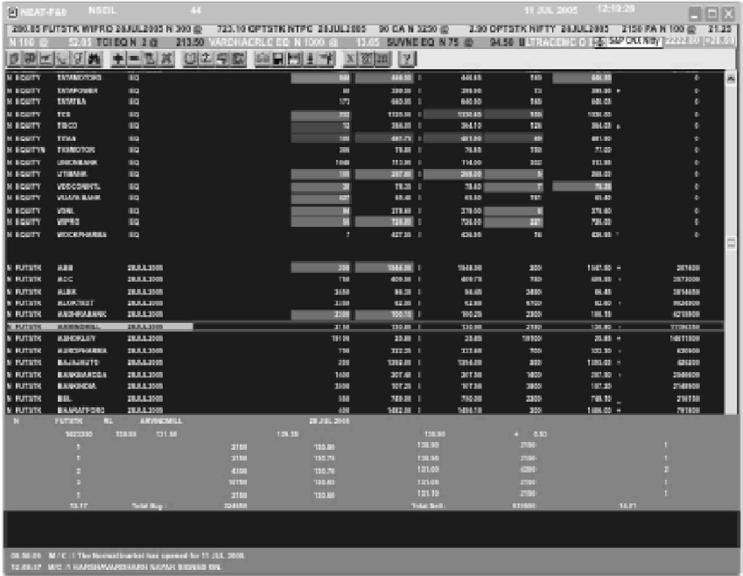
Market watch screen in NSE F&O
Notes:
The above screen shows a typical NEAT F&O screen. The details in that screen as follows
Normal market – N
Security descriptor – FUTIDX, FUTSTK, OPTIDX, OPTSTK
Scrip Name – RELIANCE, INFOSYSTCH, SATYAMCOMP, etc.
Bit qty, bit rate, ask rate, ask qty, last traded price and open interest.

Slide 11
Options
An option gives a person the right but not the obligation to buy or sell something.
An option is a contract between two parties wherein the buyer receives a privilege for which he pays a fee (premium) and the seller accepts an obligation for which he receives a fee.
The premium is the price negotiated and set when the option is bought or sold.
A person who buys an option is said to be long in the option.
A person who sells (or writes) an option is said to be short in the option.
Notes:
For example, buying a call option provides the right to buy a specified quantity of a security at a set strike price at some time on or before expiration, while buying a put option provides the right to sell. Upon the option holder's choice to exercise the option, the party who sold, or wrote, the option must fulfill the terms of the contract.

Slide 12
Option Types
American options: American options are options that can be exercised at any time upto the expiration date. Most exchange-traded options are American(Ex. Stock Options).
European options: European options are options that can be exercised only on the expiration date itself. Example for European option is Index Options.
Notes:
European option - an option that may only be exercised on expiration.
American option - an option that may be exercised on any trading day on or before expiration.

Slide 13
Option Terminology
Index Option: These options have the index as the underling. Some options are European while others are American.
Stock Option: Stock options are options on individual stocks.A contract gives the holder the right to buy or sell shares at the specified price.
Buyer of an option: The buyer of an option is the one who by paying the option premium buys the right but not the obligation to exercise his option on the seller / Writer.
Writer of an option: The writer of a call/put option is the one who receives the option premium and is thereby obliged to sell/buy the asset if the buyer exercises on him.
Notes:
Buying an option (call/put) is very safe compare to selling an option. i.e. if you buy 1000 IFCI-27-Nov-08 with strike of 20 CA @ 5 then you have to pay or your max loss is Rs.5000 (the paid premium only loss). But you can get unlimited profit if the share is went up above 20.
But in case of option selling the only profit the seller will get Rs.5000 ( i.e. premium only), at the same time if the spot price is gone up/down (put/call) then the loss will be unlimited.

Slide 14
Types of Option
Call Options: A Call option gives the buyer the right, but not the obligation to buy a given quantity of the underlying assets, at a given price on or before a given future date.
Put Options: A Put option give s the buyer the right, but not the obligation to sell a given quantity of the underlying assets, at a given price on or before a given future date.
Option price/premium: At the time of buying an option contract, the buyer has to pay premium. The premium is the price for acquiring the right to buy or sell. It is price paid by the option buyer to the option seller for acquiring the right to buy or sell. Option premium are always paid upfront.
Expiration Date: The date specified in the options contract is known as the expiration date, the exercise date, the strike date or the maturity.
Strike price: The price specified in the options contract is known as the strike price or the exercise price.
Notes:
Call: upside or bullish market gives more profit, when a client buy a call option
Put: downside or bearish market gives more profit, when he/she buy a put option (instead of selling buy put option).

Slide 15
Methods of Options
In-the-money option: An in-the-money(ITM) option is an option that would lead to a positive cashflow to the holder if it were exercised immediately. A call option on the index is set to be in-the-money when the current index stands at a lever higher than the strike price ( i.e. spot price > strike price). If the index is much higher than the strike price, the call is set to be deep ITM. In case of a Put, the put is ITM if the index is below the strike price.
At-the-money option: An at-the-money(ATM) option is an option that would lead to zero cashflow if it were exercised immediately. An option on index is at-the-money when the current index equals the strike price ( i.e. spot price = strike price).
Out-of-money option: An out-of-money(OTM) option is an option that would lead to negative cashflow if it were exercised immediately. A call option on the index is out-of-money when the current index stands at a level which is less than the strike price (i.e. spot price < strike price). If the index is much lower than the strike price, the call is said to be deep OTM. In case of a put, the put is OTM if the index is above the strike price.
Notes:
In-the-money : Call option : if you bought 1 lot of(I.e. 200) Infosys with a strike price 1200 and a premium of Rs.75 and the spot price is 1215, then 1215> 1200( spot > strike) so we may say the option is In-the-money. But comparing with Put option the Spot > strike so the option is out-of-money.

Slide 16
Market Instruments
The F&O Segment of NSE provides trading facilities for the following derivative instruments:
1. Index based futures – FUTIDX
2. Index based options – OPTIDX
3. Individual stock options – OPTSTK
4. Individual stock futures – FUTSTK

Slide 17
Contract Specification
Trading cycle: At any given point of time, three contracts are available for trading – a near-month, a middle-month and a far-month. Every contract expires on the last Thursday of the month.
Contract size: Permitted lot size (minimum value Rs.2 Lakhs)
Expiry day: The last Thursday of the expiry month the previous trading day if the last Thursday is a trading Holiday.
Settlement basis: Mark to market and final settlement will be cash settled on T+1 basis.
Settlement price: Daily settlement price will be the closing price of the future contracts for the trading day and the final settlement price shall be the closing value of the underlying index on last trading day.

Slide 18
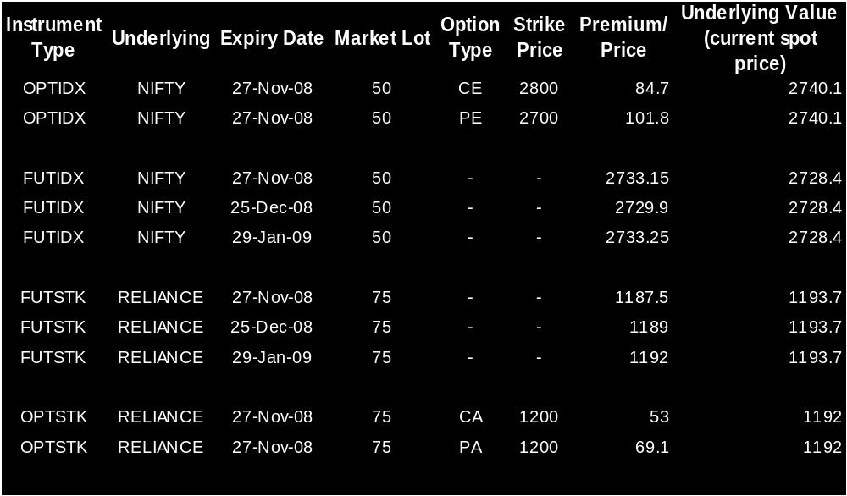
F&O Contract Specification
Example of contract Specification for Future Index, Future Stock, Option Index and Option Stock.
In options, CE – defines Call European and PE – Put European
CA – Call American and PA – Put American
Notes:
If you want to buy 1 lot of Reliance then , you must put a rate of 1187.5 to get the Reliance.so you may confirm the trade as
Bought 75 FUTSTK Reliance 27-Nov-08 @ 1187.50

Slide 19
Application of Futures & Options
Hedging:
  Futures: Long Security, sell Futures
  Options: Have underlying buy puts
Speculation:
  Futures:
    Bullish security, buy futures
    Bearish security, sell futures
  Options:
    Bullish security, buy calls or sell puts
    Bearish security, sell calls or buy puts
Arbitrage:
  Futures:
    Overpriced futures: buy spot, sell futures
    Underpriced futures: buy futures, sell spot
  Options:
    Bull spreads: Buy a call and sell another
    Bear spreads: Sell a call and buy another
Notes:
Spread: A spread trading strategy involves taking a position in two or more options of the same type, that is, two or more calls or two or more puts.
A spread that is designed to profit if the price is goes up is called a bull spread otherwise bear spread.
Hedging: if a client is long 200 shares of JPHYDRO then he may sell JPHYDRO futures or buy PUT option to hedge the position.
Speculation: if a client is bullish on market, he may buy the security or index futures or buy call options or sell put options.
if a client is bearish on market, he may sell the security or index futures or buy put options or sell call options.
Arbitrages: if a client feel the market is overpriced(in futures), then buy in spot market and sell futures. If the market is Underpriced then buy futures and sell in spot market.
if it is in options, spread the option by buying and selling.

Slide 20
Generation of strikes for stock options
Price of underlying Strike Price interval Scheme of Strikes to
be introduced ( ITM-ATM-OTM)
Less than or equal to Rs.50 2.5 3 – 1 – 3
>Rs.50 – Rs.250 5 3 – 1 – 3
>Rs.250 – Rs.500 10 3 – 1 – 3
>Rs.500 – Rs.1000 20 3 – 1 – 3
>Rs.1000 – Rs.2500 30 3 – 1 – 3
>Rs.2500 50 3 – 1 – 3
Generation of strikes for Nifty options
Index level Strike interval Scheme of Strikes
to be introduced
( ITM-ATM-OTM)
Upto 2000 25 4 – 1 – 4
From 2001 to 4000 50 4 – 1 – 4
From 4001 to 6000 50 5 – 1 – 5
>6000 50 6 – 1 – 6
Notes:
Note : ITM : in-the-money , ATM: at-the-money, OTM: out-of-money
Which means if a strike price is 200, then it may have 3-1-3 scheme with 5 strike price intervals (180,190,195,200,205,210,215 are the active strike prices)

Slide 21
Charges
The maximum brokerage chargeable by the trading member in relation to trades effected in the contracts admitted to dealing on the F&O segment of NSE fixed at 2.5% of the contract value in case of index futures and stock futures.
In case of index options and stock options it is 2.5% or Rs.100/- which ever is high.
The Transaction charges payable by a trading member for the trades executed my him are .002% on turnover.
The SEBI charges payable is .0002% on turnover.
The Securities Transaction Tax (STT) for F&O segment is as follows.
* sale of an option and securities:- 0.017%
* sale of an option in securities where option is exercised:- 0.125%
Notes:
STT calculation : bought 100 Nifty @ 2700 value = 270000/- and sold 150 Nifty @2725 with value = 408750/-, here the STT is calculated on the sales only. i.e. STT = 408750*.017% = 69/-

Slide 22
Trading System
Four entities in the trading systems are
Trading members: Trading members are member of any exchange(ex. NSE). They can trade either on their own account or on behalf of their clients including participants. Each trading member can have more than one user.
Clearing members: Clearing members are members of NSCCL. They carry out risk management activities and confirmation/inquiry of trades through the trading members.
Professional clearing members: Professional clearing members is a clearing member who is not a trading member. Typically, banks and custodians become professional clearing members and clear and settle for their trading members.
Participants: A Participant is a client of trading members like financial institutions. These clients may trade through multiple trading members but settle through a single clearing member.
Notes:
TM: either trade in PRO account or CLI account by register the client code with NSE.
CM: clears the trades of TM
PCM: clears one or more TMs trades. Ex. Custodians and banks like IL&FS, SHICL, HSBC, HDFC, ICICI etc
Participants: trades in multiple TM and Settle the trades in a single CM. Ex. Fin. Institutions like IL&FS, SHCL, Federal bank,etc

Slide 23
Basis of Trading
The NEAT F&O system supports an order driven market, wherein orders match automatically. Order matching is essentially on the basis of security, its price, time and quantity. All quantity fields are in units and price in rupees.
The Exchange notifies the regular lot size and tick size for each of the contracts traded on this segment from time to time.
When any order enters the trading system, it is an active order. It tries to find a match on the other side of the book. If it finds a match, a trade is generated. If it does not find a match, the order becomes passive and goes and sits in the respective outstanding order book in the system.

Slide 24
Client-Broker Relationship
A trading member must ensure compliance particularly with relation to the following while dealing with clients:
Filling of ‘Know Your Client’ form
Execution of Client Broker agreement
Bring risk factors to the knowledge of client by getting acknowledgement of client on risk disclosure document
Timely execution of orders as per the instruction of clients in respective client codes.
Collection of adequate margins from the client
Maintaining separate client bank account for the separation of client money
Timely issue of contract notes as per the prescribed format of the client.
Notes:
KYC: account opening form.

Slide 25
Client-Broker Relationship
Ensure timely pay-in and pay-out of funds to and from the clients
Resolving complaint of clients if any at the earliest
Avoiding receipt and payment of cash and deal only through account payee cheques
Sending the periodical statement of accounts to clients
Not charging excess brokerage
Maintaining unique client code as per the regulations.

Slide 26
Clearing and Settlement
National Securities Clearing Corporation Limited(NSCCL) undertakes clearing and settlement of all trades executed in the futures and options (F&O) segment of the NSE.
Clearing Entities:
  Clearing Members: Self clearing members, clear and settle their trades executed by them only either on their own account or on account of their clients.
  Clearing Bank: Funds settlement takes place through clearing banks. For the purpose of settlement all clearing members are required to open a separate bank account with NSCCL designated clearing bank for F&O Segment.
Notes:
Clearing – Computing obligations of all his TM's i.e. determining positions to settle.
Settlement - Performing actual settlement. Only funds settlement is allowed at present in Index as well as Stock futures and options contracts
Risk Management – Setting position limits based on upfront deposits / margins for each TM and monitoring positions on a continuous basis.
There are two bank accounts are operated by the TM. One is client account, which is used for giving payout and get pay-in of clients. Second is settlement account, which is operated by NSCCL to settle the daily obligation.

Slide 27
Clearing & settlement Mechanism
Clearing: The clearing mechanism essentially involves working out open positions and obligations of clearing (self-clearing/trading-cum-clearing/ professional clearing) members. A TM’s open position is sum of proprietary open position, client open long position and client open short position.
Settlement: All futures and options contracts are cash settled, i.e. through exchange of cash. The underlying for index futures/options of the Nifty index cannot be delivered. These contracts, therefore, have to be settled in cash. And same like index futures, Individual securities also be cash settled.
Notes:
Clearing: PRO and CLI open positions and obligations are cleared by CM
Settlement: All contracts are settled by cash through settlement account.

Slide 28
Settlement of Option Contracts
Option contracts have three types of settlements, daily premium settlement, exercise settlement, interim exercise settlement in case of option contracts on securities and final settlement.
Daily premium settlement:
  Buyer of an option is obligated to pay the premium towards the options purchased by him.
  Seller of an option is entitled to receive the premium for the option sold by him.
Exercise settlement:
  Most option buyer and seller closeout their positions by an offsetting closing transaction.
  Exercise always had more advantages than an offsetting sale for the option buyer.
  There is always a possibility of the option sell being assigned an exercise.
  Once an exercise of an option has been assigned to an option seller, he is bound to fulfill his obligation.
Notes:
Daily buy or sell option is settled by cash.
Exercise of option gives more advantages than offsetting.
In-the-money contract is settled through exercise and gets the obligation from the counterparty.
Final settlement if done on expiry date.

Slide 29
Settlement of Option Contracts
Interim exercise settlement:
  It takes place only for option contracts on securities.
  An investor can exercise his in-the-money options at any time during trading hours, through is TM.
  The CM who has exercised the option receives the exercise settlement value per unit of the option from the CM who has been assigned the option contract.
Final exercise settlement:
  Final exercise settlement is effected for all open long In-the-money strike price options existing at the close of trading hours, on the expiration day of the option contract.
  All such long positions are exercised and automatically assigned to short positions in option contracts with the same series, on a random basis.
  The investor who has in-the-money options on the expiry date will receive the value from the investor who has been assigned the option contract.

Slide 30
Adjustments for Corporate Actions
Corporate actions can be broadly classified under stock benefits and cash benefits.
The various stock benefits declared by the issuer of capital are bonus, rights, merger/de-merger, amalgamation, splits, consolidations, Warrants and secured premium notes (SPNs) among others.
The cash benefits declared by the issuer of capital is cash dividend.
Any adjustment for corporate actions is carried out on the last day on which a security is traded on cum basis in the underlying equities market, after the close of trading hours.
Adjustments may entail modifications to positions and/or contract specifications as listed below,
  Strike price
  Position
  Market lot / multiplier
Notes:
A split of ITC share is defines as:
Previous day position in futures : A is Long 1 lot of ITC ( 1 lot =150)
After corporate action the future position become 300. So the position of A had ITC 1 lot long( i.e. 300)

Slide 31
Risk Management
NSCCL has developed a comprehensive risk containment mechanism for the F&O segment.
The financial soundness of the members is the key to risk management. Therefore, the requirement for membership in terms of capital adequacy (net worth, security deposits) are quite stringent.
NSCCL charges an upfront initial margin for all the open positions of a CM on a daily basis.
The open positions of the members are market-to-market based on contract settlement price for each contract. The difference is settled in cash on a T+1 basis.
NSCCL’s on-line monitoring system monitors a CM’s open positions on a real-time basis. Limits are set for the CM based on his capital deposits.
CM’s are provided a trading terminal for the purpose of monitoring the open positions of all TM’s clearing and settling through him.
A member is alerted of his position to enable him to adjust his exposure or bring in additional capital.
A separate settlement guarantee fund for this segment has been created out of the capital of members.

Slide 32
Regulatory Framework
The trading of derivatives is governed by the provisions contained in the Securities Contracts (Regulation) Act, the SEBI Act, the rules and regulations framed thereunder and the rules and bye-laws of stock Exchanges.
SC(R)A-Securities Contracts (Regulations) Act, 1956:
  SC(R)A aims at preventing undesirable transactions in securities by regulating the business of dealing therein and by providing for certain other matters connected therein.
  This is principal Act, which governs the trading of securities in India.
SEBI Act, 1992:
  SEBI Act,1992 provides for establishment of Securities and Exchange Board of India (SEBI) with statutory powers for
    Protecting the interests of investors in securities
    Promoting the development of the securities market
    Regulating the securities market.

Slide 33
Thank you

